Slide 1
Predicting Area for opening restaurant

Slide 2
Suggesting areas for restaurant
Using Foursquare API for knowing different locations venues and names which help in predicting locations
collect data from Wikipedia for Canada postal code and nebhourhood use to extract them for clustering
It is helpful for earn maximum profit from restaruant

Slide 3
Data cleaning
First explore the data and append it with longitude and latitude of respective locations
Then remove any missing value by drop or fill with mean
Then use foursquare to get venues of different locations respectively

Slide 4
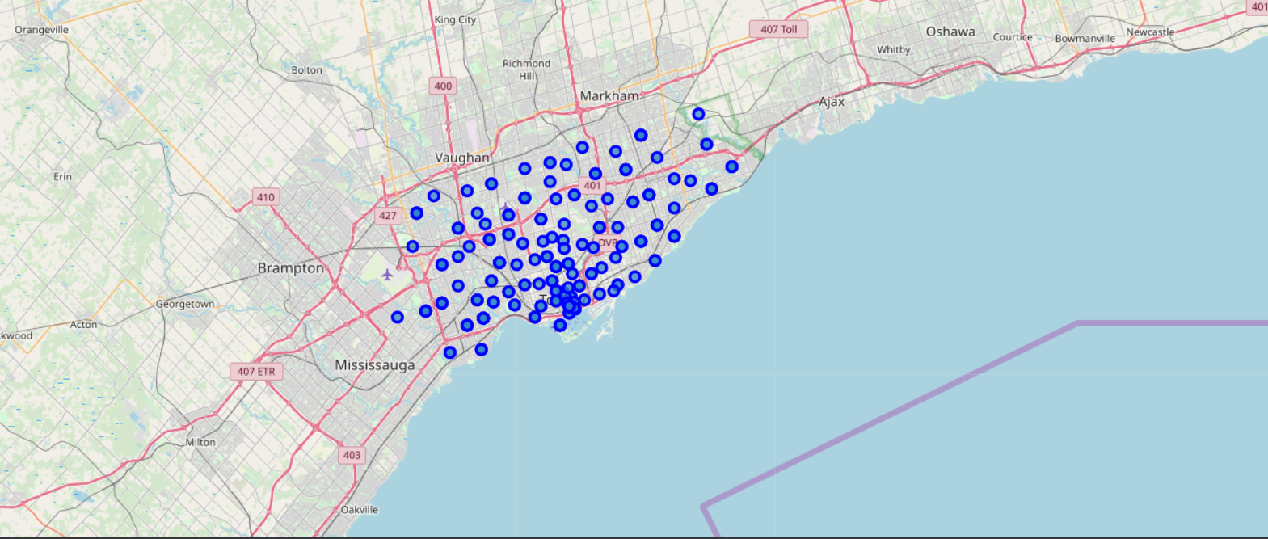
Data visualisation using folium

Slide 5
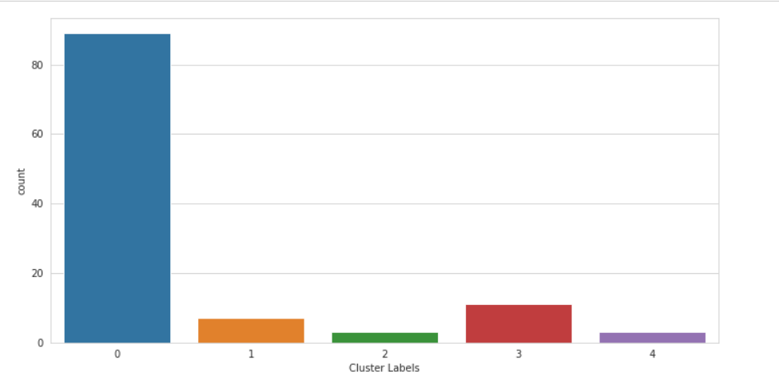
Data visualisation using seaborn

Slide 6
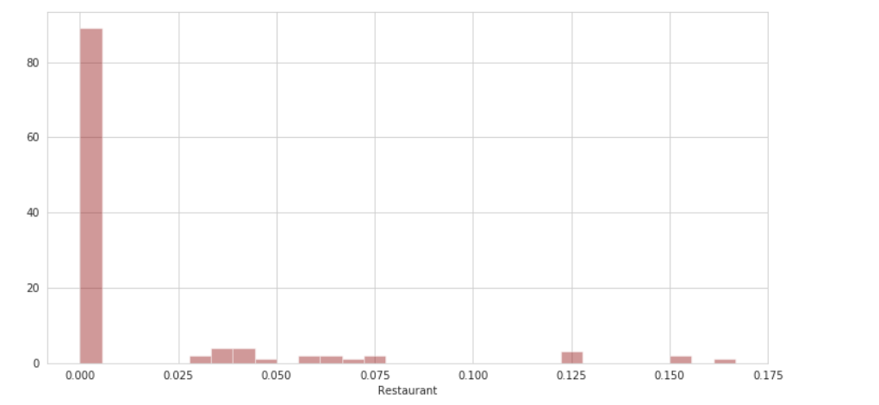

Slide 7
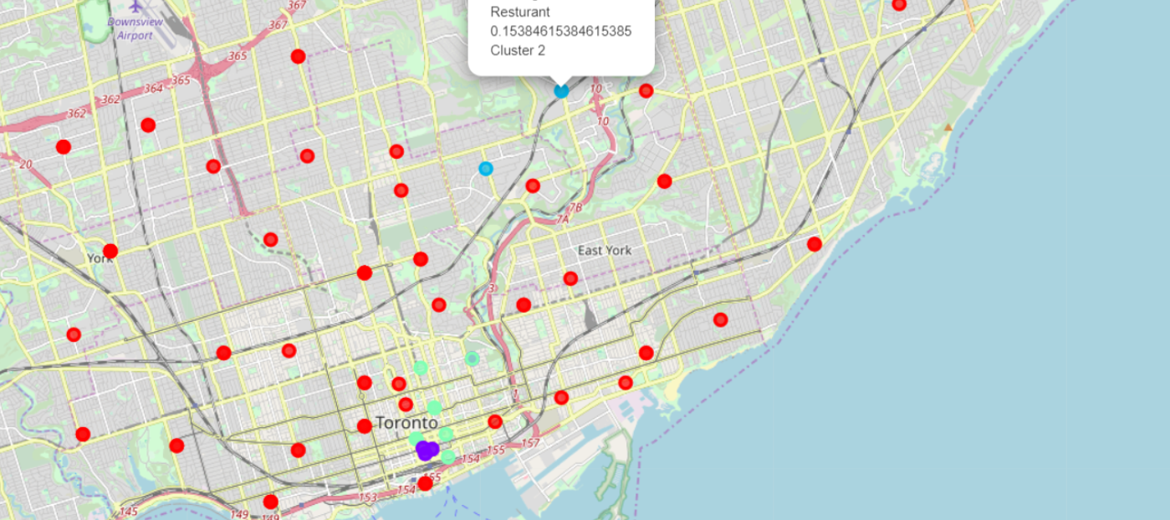
Data visualisation after Kmeans clustering

Slide 8
Conclusion
I also study a different type of restaurant and analyse them
I conclude that the best place for a restaurant in nearby St. Andrew, King, and many other places

